Slide 1

CPE 431/531 Chapter 1 - Computer Abstractions and Technology
Dr. Rhonda Kay Gaede

Slide 2
1.1 Introduction
The computing industry embraces ___________ at a breathtaking rate.
If transportation had kept pace with computing, today we could travel coast to coast in about _________ for __________
Revolutions
_______________, _____________, ____________
Recent innovations enabled by computing
__________________________
_____________
______________________
Tommorrow’s Killer Apps
____________________
___________________
___________________

Slide 3
1.1 Classes of Computing Applications
Personal Computers
________________________________
___________________________
Servers
_____________________________
_________________
_________________________
Supercomputers
_________________
____________________
Embedded Computers
_______________________________
___________________________________________

Slide 4
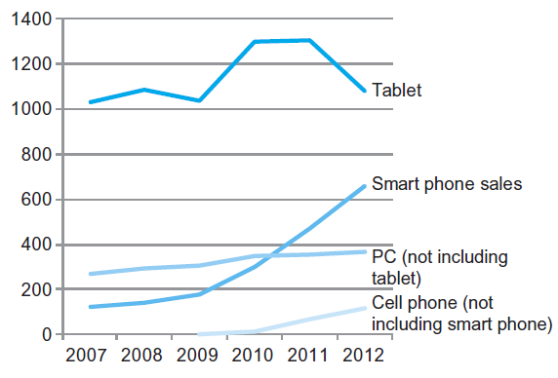
1.1 The PostPC Era

Slide 5
1.1 What You Can Learn in This Book
How are programs written in a _________ language translated into ____________________________ and how does the _________ execute the resulting program?
What is the ________ between the _________ and the ___________?
What determines the _____________ of a ___________?
What techniques can be used by __________ ___________ to improve performance?
What are the ________ for and the ______________ of the switch from _____________ processing to _________ processing?

Slide 6
1.1 Elements Contributing to Program Performance
______________________
________________________________
______________________________
________________________________________

Slide 7








1.2 Eight Great Computer Architecture Ideas
Design for Moore’s Law
Use abstractions to simplify design
Make the common case fast
Performance via Parallelism
Performance via Pipelining
Performance via Prediction
Hierarchy of Memories
Dependability via Redundancy

Slide 8
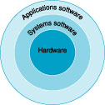
1.3 Below Your Program
Operating system
Interface between _____________ and the _________
Handles ________ ___
Allocates ________ and __________
Provides for __________ ________
Compiler
___________________________________
_______________________

Slide 9
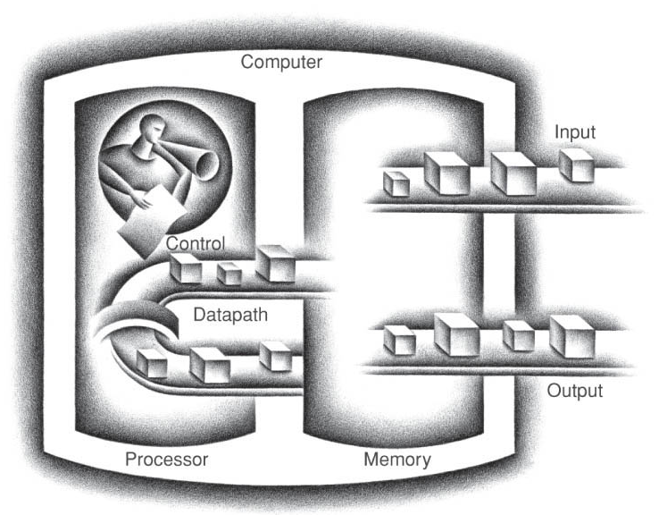
1.4 Under the Covers – The BIG Picture

Slide 10
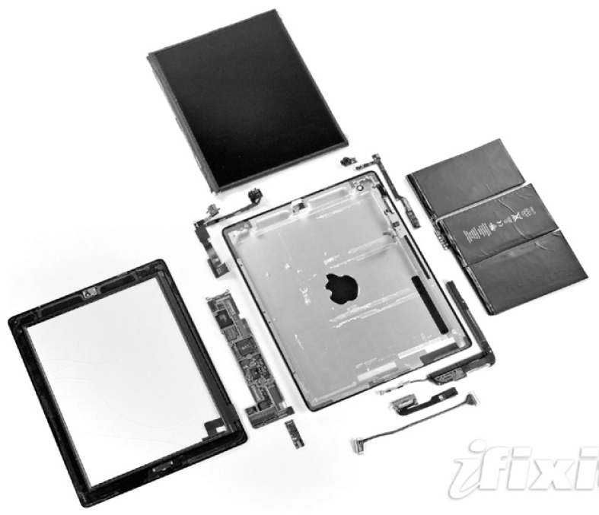
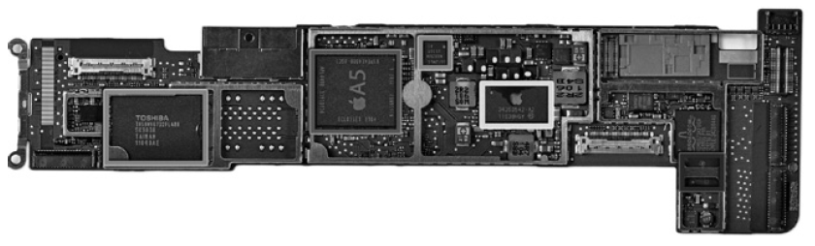
1.4 Under the Covers – Apple iPad 2
Capacitive multitouch LCD screen
3.8 V, 25 Watt-hour battery
Computer board

Slide 11
1.4 Communicating with Other Computers
Network Services
________________
______________
________________
Types of Networks
______ ____ network (Ethernet)
______ ______ network (Fiber optic cables)
_________

Slide 12
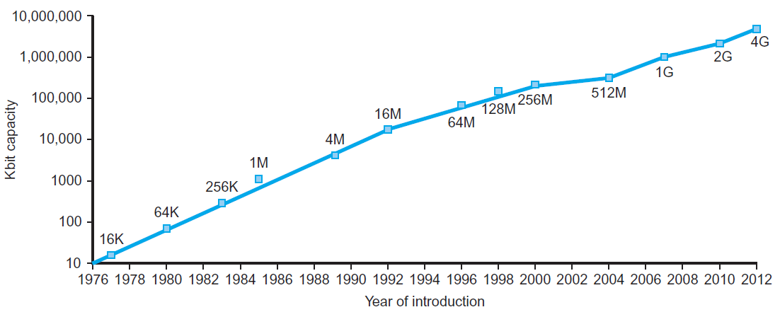
1.5 Technologies Enabling Processors and Memory
Electronics technology continues to evolve
Increased ________ and _____________
Reduced _____
DRAM capacity
Year | Technology | Relative performance/cost
1951 | Vacuum tube | 1
1965 | Transistor | 35
1975 | Integrated circuit (IC) | 900
1995 | Very large scale IC (VLSI) | 2,400,000
2013 | Ultra large scale IC | 250,000,000,000

Slide 13
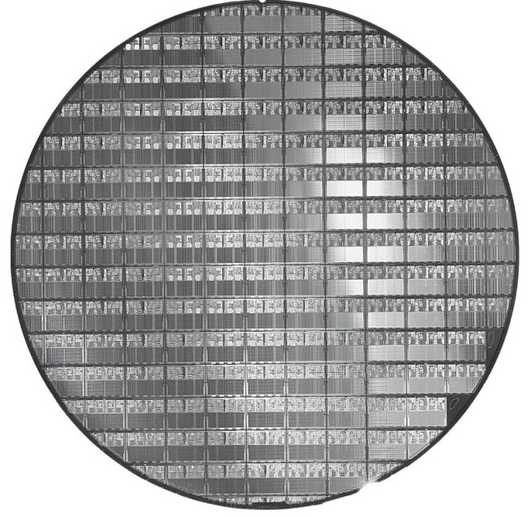
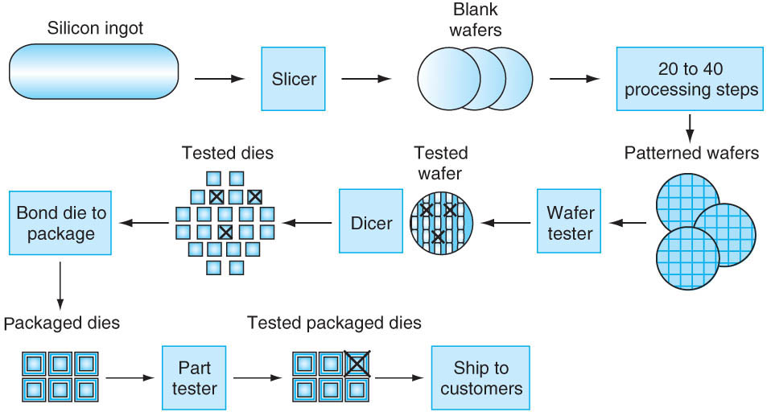
1.5 Semiconductor Manufacturing
Need different materials
___________
_________
________________

Slide 14
1.6 Performance - Motivation
Accurately measuring and comparing different computers is critical to ___________, and therefore, to ____________.
We need to understand what determines the __________________ of a computer
_________ performance and ________ performance are linked _______________

Slide 15
1.6 Defining Performance
Which airplane has the best performance?

Slide 16
1.6 Performance Metrics
Similarly, ambiguity exists when discussing computer performance.
Single program – run as quickly as possible
Many users – run as many programs as possible
The user wants __________ and the system manager wants ____________.

Slide 17
1.6 Throughput and Response Time
Do the following changes to a computer system increase throughput, decrease response time, or both?
Replacing the processor in a computer with a faster version.
Adding additional processors to a system that uses multiple processors for separate tasks, i.e., net surfing

Slide 18
1.4 Performance Related to Execution Time
Decreasing execution time increases performance.
Relating performance of two computers
ET_{A}= 10 s, ET_{B} = 15 s, how much faster is A than B?

Slide 19
1.6 Measuring Performance
_________ is the measure of computer performance
_______________________
_______________________
Users think in _________, designers think in ___________.
ET = CC * CT
ET = CC/CR

Slide 20
1.6 CPU Performance and its Factors
Example: Our favorite program runs in 10 seconds on computer A, which has a 2 GHz clock. We are trying to help a computer designer build a computer, B, that will run this program in 6 seconds. The designer has determined that a substantial increase in the clock rate is possible, but this increase will affect the rest of the CPU design, causing machine B to require 1.2 times as many clock cycles as machine A for this program. What clock rate should we tell the designer to target?

Slide 21
1.6 Instruction Performance
How does the number of instructions factor in?
Example: Suppose we have two implementations of the same instruction set architecture. Machine A has a clock cycle time of 250 ps and a CPI of 2.0 for some program, and machine B has a clock cycle of 500 ps and a CPI of 1.2 for the same program. Which machine is fastest for this program, and by how much?

Slide 22
1.6 Comparing Code Segments
Example: A compiler designer is trying to decide between two code sequences for a particular machine. The hardware designers have supplied the following CPI information and the compiler designer specifies the two segments as follows:
Instruction class CPI Instruction class CPI Instruction class CPI
A 1 B 2 C 3
Code Segment IC(A) IC(B) IC(C)
1 2 1 2
2 4 1 1
Which code segment executes the most instructions? Which will be faster? What is the CPI for each sequence?

Slide 23
1.6 Understanding Program Performance
Component Affects What
Algorithm
Programming
Language
Compiler
ISA

Slide 24
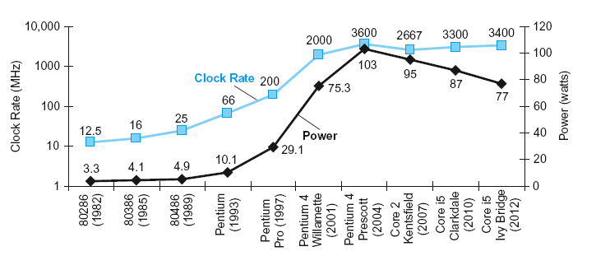
1.7 The Power Wall
We have run into the practical power limit for ________ commodity processors
For CMOS, the primary source of power dissipation is ________ power.
Power = Capacitive load x Voltage² x Frequency switched
We can lower the ______ by lowering the _______
The _______ has gone about as low as it can go, any further and there is too much _______ _______

Slide 25
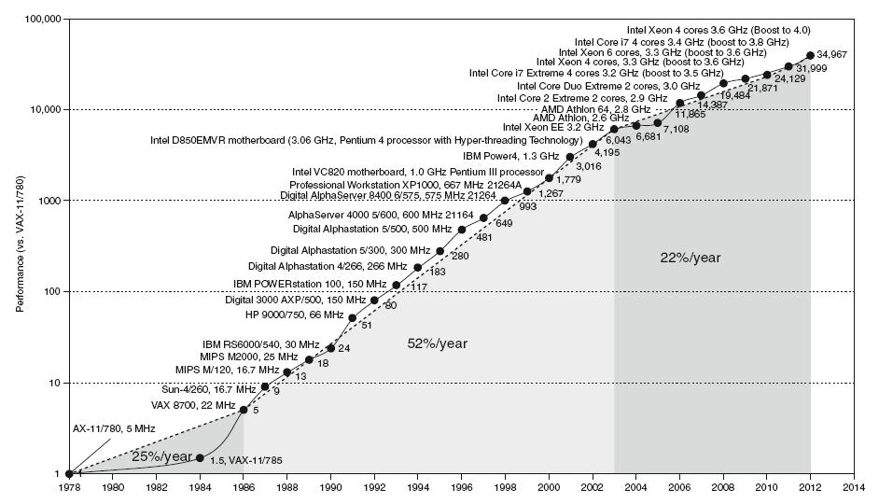
1.8 The Switch from Uni- to Multi-processors
As of 2006, all desktop and server companies started shipping __________ processors
The benefit is often more of ___________ than ___________ ______
In the past, __________ software didn’t change to achieve performance gains, the underlying hardware and attendant compiler did.

Slide 26
1.8 The Switch from Uni- to Multi-processors
Today, applications software must be rewritten to achieve performance gains.
What’s so hard about writing explicitly parallel programs?
____________________________________________________________________________________________________________
_________________________________________________

Slide 27
1.9 RealStuff: Benchmarking the Intel Core i7
The _____ executed by a computer form a __________.
A typical ___________ specifies both the _________ run and their _____________.
_____________ form a __________ that the user hopes will ________ the performance of the actual computer
SPEC (System Performance Evaluation Cooperative) is an effort funded and supported by a number of computer vendors to create __________ sets of ____________ for modern computer systems.
The first CPU performance benchmark appeared in 1989.
Today, SPEC offers a dozen different benchmarks designed to test a wide variety of computing environments, the newest is SPECpower.

Slide 28
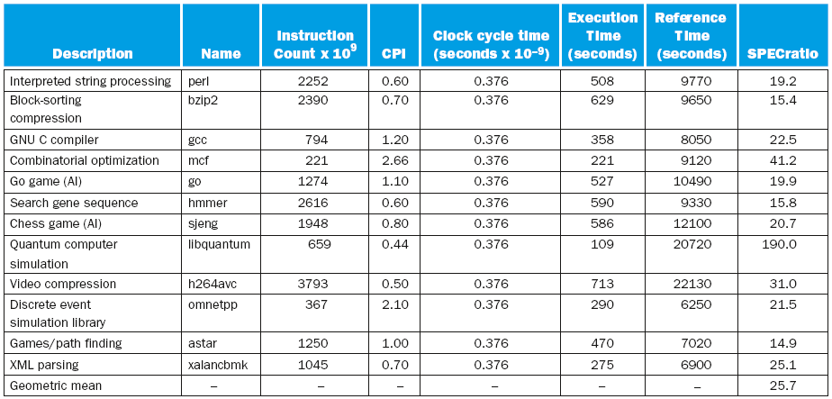
1.9 RealStuff: Benchmarking the Intel Core i7

Slide 29
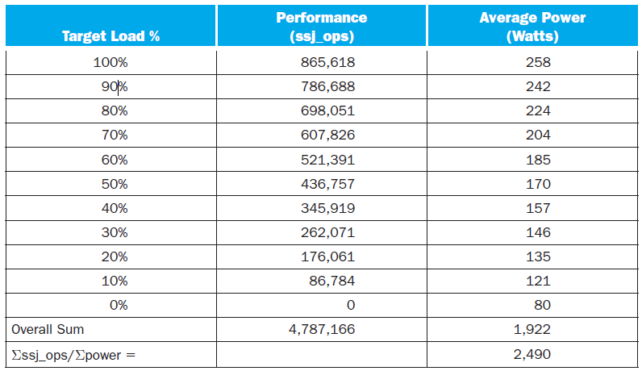
1.9 RealStuff: Benchmarking the Intel Xeon

Slide 30
1.10 Fallacies and Pitfalls
Pitfall: Expecting the improvement of one aspect of a computer to increase overall performance by an amount proportional to the size of the improvement.
Fallacy: Computers at low utilization use little power.
Fallacy: Designing for performance and designing for energy efficiency are unrelated goals.
Pitfall: Using a subset of the performance equation as a performance metric.

Slide 31
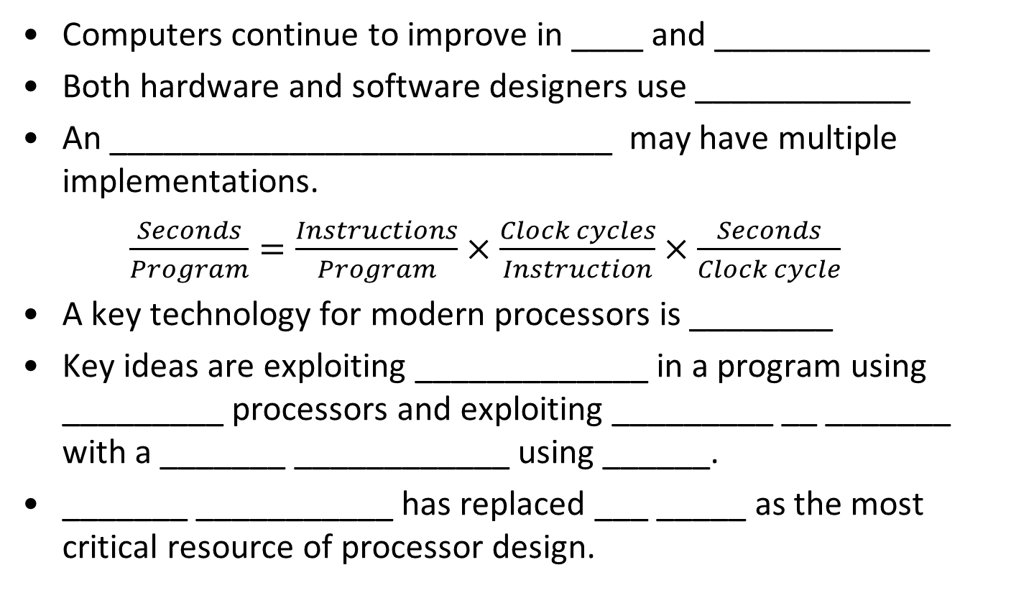
1.11 Concluding Remarks
Computers continue to improve in ____ and ____________
Both hardware and software designers use ____________
An ____________________________ may have multiple implementations.
$\frac{Seconds}{Program}=\frac{Instructions}{Program}×\frac{Clock cycles}{Instruction}×\frac{Seconds}{Clock cycle}$
A key technology for modern processors is ________
Key ideas are exploiting _____________ in a program using _________ processors and exploiting _________ __ _______ with a _______ ____________ using ______.
_______ ___________ has replaced ___ _____ as the most critical resource of processor design.

